Slide 1



Computacenter Repair Process Optimisations
BPM Team A11 · M. Shaw, P. Goyal, S. Gelli, T. Grünenfelder, V. R. Tella

Slide 2
Overview
Case
Solution

Slide 3
Case
Case

Slide 4
Computacenter
Case
Based in the UK
20'000 employees worldwide
Branch in CH; 250 employees
Hard to be profitable

Slide 5
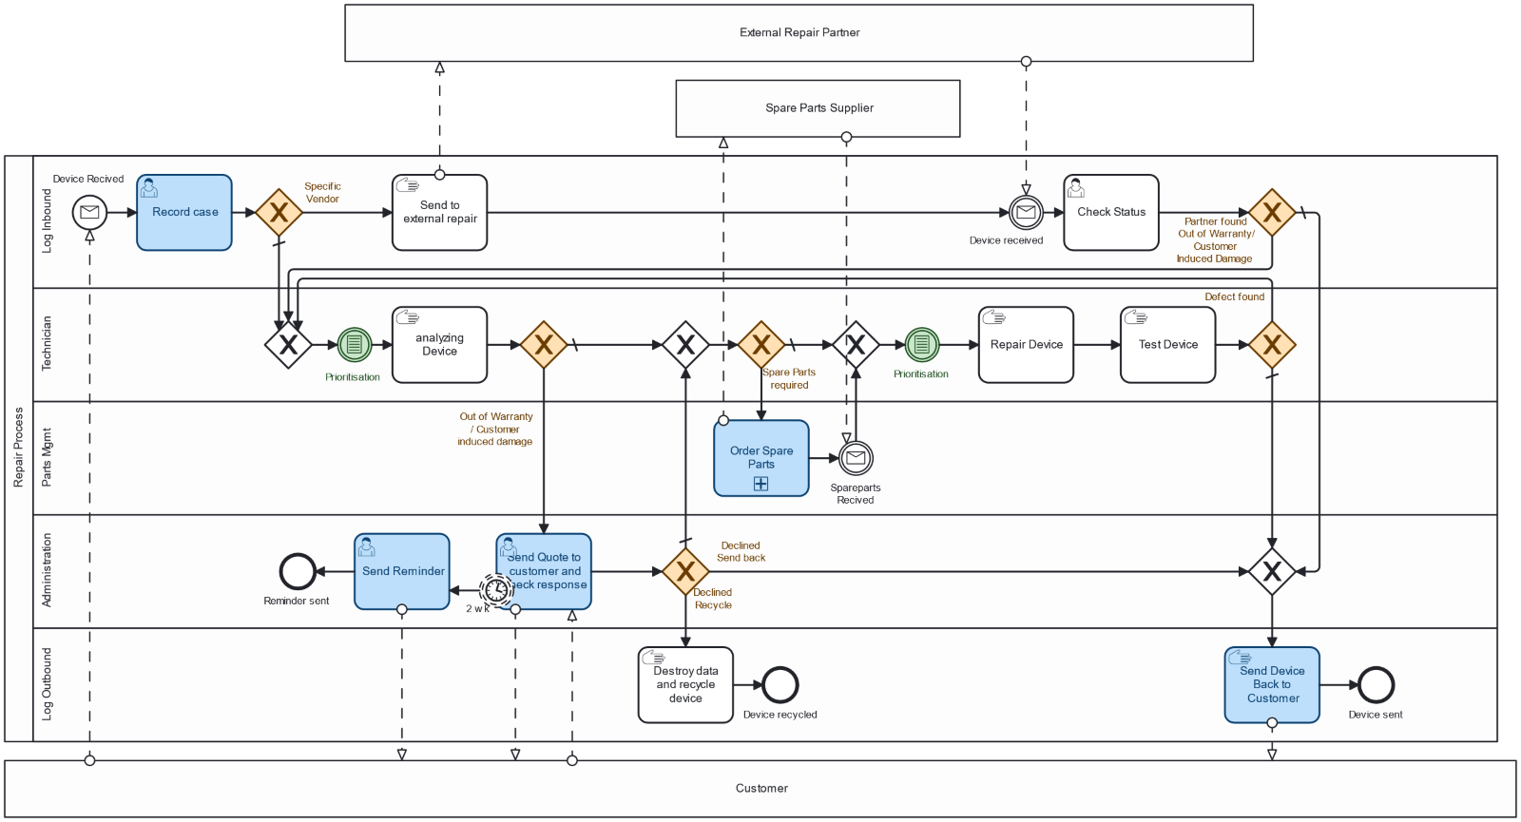
Repair-Process
Case

Slide 6
Painpoints
Case
Manual labour for admin
Number of admin tasks
Ducumentation takes a long time
Using too many tools
Manual priotisation within an Excel list
Sending reminders is time consuming
Creating of an offer requires a lot of manual labour
Notes:
Start with questionaire and multiple interview which lead us to these painpoints

Slide 7
Solution
Solution
Subtitle

Slide 8
Approach
Solution
System Integration and Automation
Continouous Improvement

Slide 9
Approach
Solution
System Integration and Automation
Continouous Improvement

Slide 10
Approach
Solution
System Integration and Automation
Continouous Improvement

Slide 11
Recommendation
Solution
Preregister of cases
Automatic Warranty Check
Automatic Manufacturer Case
Automatic Chase
EDI spare parts ordering
Catalogue Platform
Value suggestions and drive small improvements
Purchase Process for Spare Parts in Abacus
Cross-training for multiple roles
Prioritisation in automated BI Dashboard
Standardised Packaging
Notes:
11

Slide 12
Recommendation
Solution
Preregister of cases
Automatic Warranty Check
Automatic Manufacturer Case
Automatic Chase
EDI spare parts ordering
Catalogue Platform
Value suggestions and drive small improvements
Purchase Process for Spare Parts in Abacus
Cross-training for multiple roles
Prioritisation in automated BI Dashboard
Standardised Packaging

Slide 13
Automatic warranty check
HP.com/warranty
_
+
X
Abacus ERP System
Solution
_
+
X
Serial number
Manufacturer
5XKT4N8Q8
HP
Go
Go
Serial number
5XKT4N8Q8
Warranty Date:
Warranty Date
08/05/2025
08/05/2025
13

Slide 14
Automatic warranty check
Solution
Robotic Automation

Slide 15
Automatic warranty check
Solution
Robotic Automation
Browser Emulation

Slide 16

Automatic warranty check
HP.com/warranty
_
+
X
Abacus ERP System
Solution
_
+
X
Serial number
Manufacturer
5XKT4N8Q8
HP
Go
Go
Serial number
5XKT4N8Q8
Warranty Date:
Warranty Date
08/05/2025
16

Slide 17
Automatic warranty check
HP.com/warranty
_
+
X
Abacus ERP System
Solution
_
+
X
Serial number
Manufacturer
5XKT4N8Q8
HP
Go
Go
Serial number
5XKT4N8Q8
Warranty Date:
08/05/2025
Warranty Date
08/05/2025
08/05/2025
17

Slide 18
Automatic warranty check
Solution
Robotic Automation
Browser Emulation
API Integration

Slide 19
Automatic warranty check
Abacus ERP System
Solution
Manufacturer
HP
Serial number
5XKT4N8Q8
Warranty Date
08/05/2025

Slide 20
Automatic warranty check
Solution
Robotic Automation
Browser Emulation
API Integration
Complexity
Notes:
Outcome: in all cases reduction in processing type

Slide 21
Automatic warranty check
Solution
Robotic Automation
Browser Emulation
API Integration
Volatility
Notes:
Outcome: in all cases reduction in processing type

Slide 22
Recommendation
Solution
Preregister of cases
Automatic Warranty Check
Automatic Manufacturer Case
Automatic Chase
EDI spare parts ordering
Catalogue Platform
Engourage suggestions and drive small improvements
Purchase Process for Spare Parts in Abacus
Cross-training for multiple roles
Prioritisation in automated BI Dashboard
Standardised Packaging
Notes:
Keyword: Kaizen

Slide 23
Encourage suggestions
Solution
Why
Accumulate small improvements
Gain flexibility
Notes:
The Manufacturer Webpage is too slow
Not enough staff

Slide 24
Encourage suggestions
Solution
How
Implement Process
Dedicate Ressources
Train Employees
Allow for failure, Celebrate Success
Notes:
The Manufacturer Webpage is too slow
Not enough staff

Slide 25
Computacenter Repair Process Optimisations
BPM Team A11 · M. Shaw, P. Goyal, S. Gelli, T. Grünenfelder, V. R. Tella

